Slide 1


COMPUTEROME 2.0
USERS WORKSHOP
Center for Health DATA SCIENCE (HEADS)
Faculty of Health and Medical Sciences,
University of Copenhagen, February, 2021

Slide 2


02
CENTER FOR HEALTH DATA SCIENCE
SERVICES
TRAINING
RESEARCH
Provide SUND researchers with health data science services and provide training.
Courses
Workshop
Seminars
Conferences
Heath Data
Internal Projects
External Projects
Grants
Consultancy
Collaboration
Matchmaking
Establish health data science as a topic in its own right and conduct its own research.
Started March 2020.
Located at Panum Institute.

Slide 3
04
4
CENTER FOR HEALTH DATA SCIENCE
CPR
RESEARCH
BIO- STAT
HeaDS is a Hub for health data science research.
The Hub will connect groups and sections at SUND (spokes) within the field of data science research:
Coordination
Collaboration
Workshops, Seminars, …
Visibility
Visibility
HUB
Center for Health
Data Science
GLOBE
The Center will seek to obtain external funding to fuel more research in health data science - groups within the Center.
BRIC
(…)

Slide 4
05
7
DATA SCIENCE LAB – SERVICES
CENTER FOR HEALTH DATA SCIENCE
An essential part of the Centers activities is Support and Service for SUND researchers.
General services (Computerome, data-mangement etc.) or more specialized (e.g., NGS analysis).
Collaboration with HeaDS Data Lab (agreement on payment and/or co-authorships before-hand).
Discussion of data science questions, resulting in referral to other data lab.
CONSULTATON
MATCHMAKING
REFERRAL
COLLABORATION
Discussion of data science questions, resulting in ideas, guidance, tips and analysis.
Connection of researchers with common interests, and complementary skills for collaboration.

Slide 5


RESEARCH
06
9
DATA SCIENCE LAB - COURSES
CENTER FOR HEALTH DATA SCIENCE
Course Coordination:
Python Tsunami, Spring 2021 (two times).
R courses:
From Excel to R (module 1) - Right now!
More R modules in collaboration biostatistics.
R
COURSES
Git/Github Workshop (Reproducible Science):
April, 2021.
WORKSHOPS
Computerome 2.0 Users Workshop:
February, 2021 - Collaboration Globe & Danstem
SEMINARS
CONFERENCES
Analysis of Next Generation Sequencing Data
Summer, 2021.

Slide 6
COMPUTEROME 2.0
USERS WORKSHOP
Center for Health DATA SCIENCE (HEADS)
Faculty of Health and Medical Sciences,
University of Copenhagen, February, 2021

Slide 7
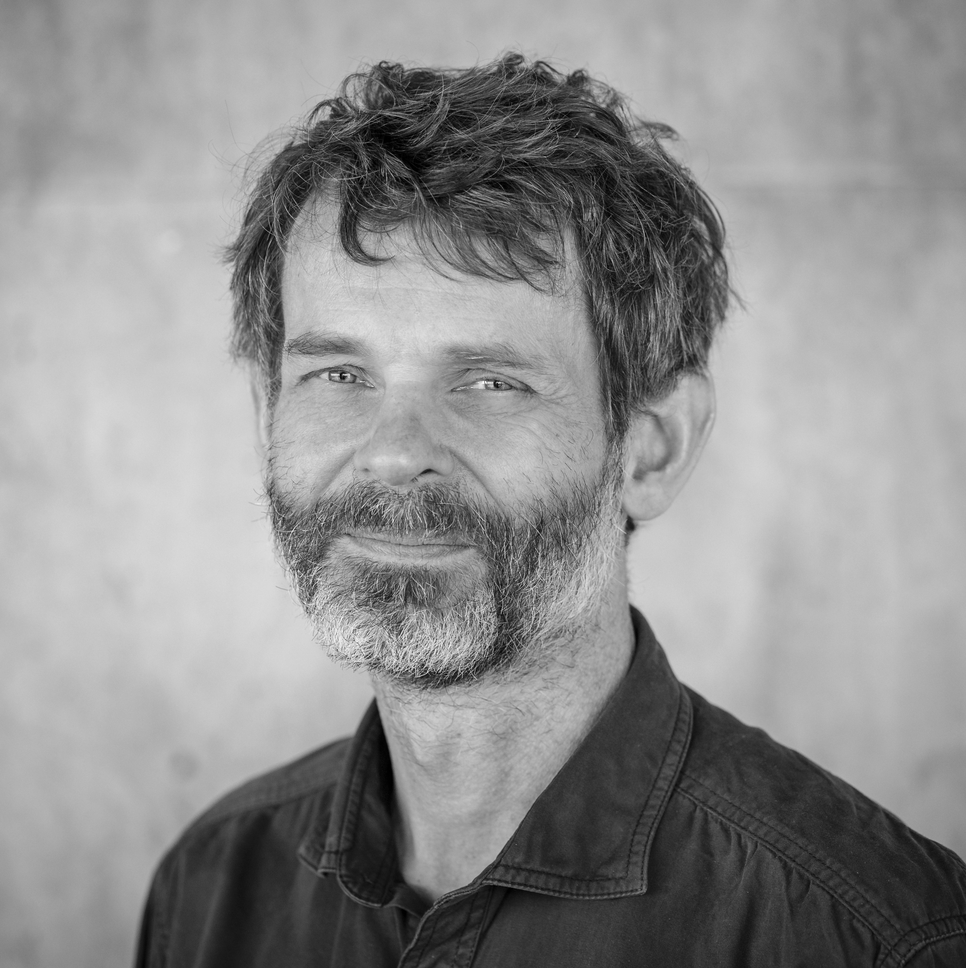
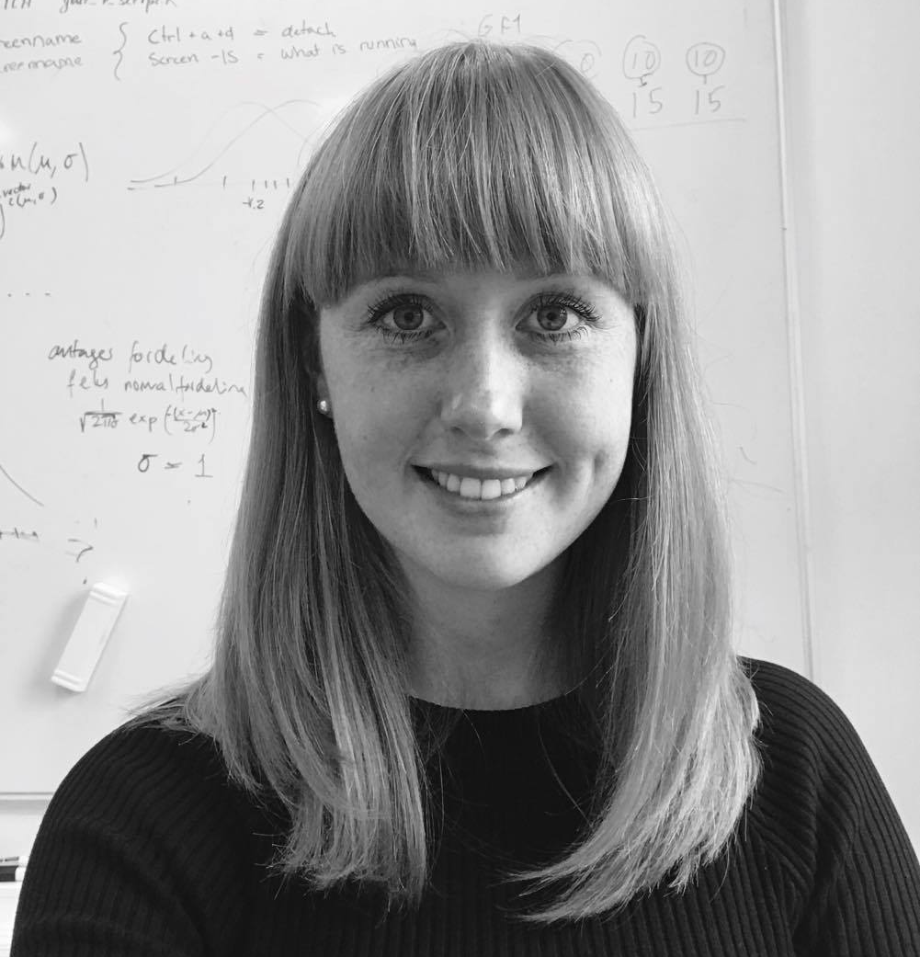
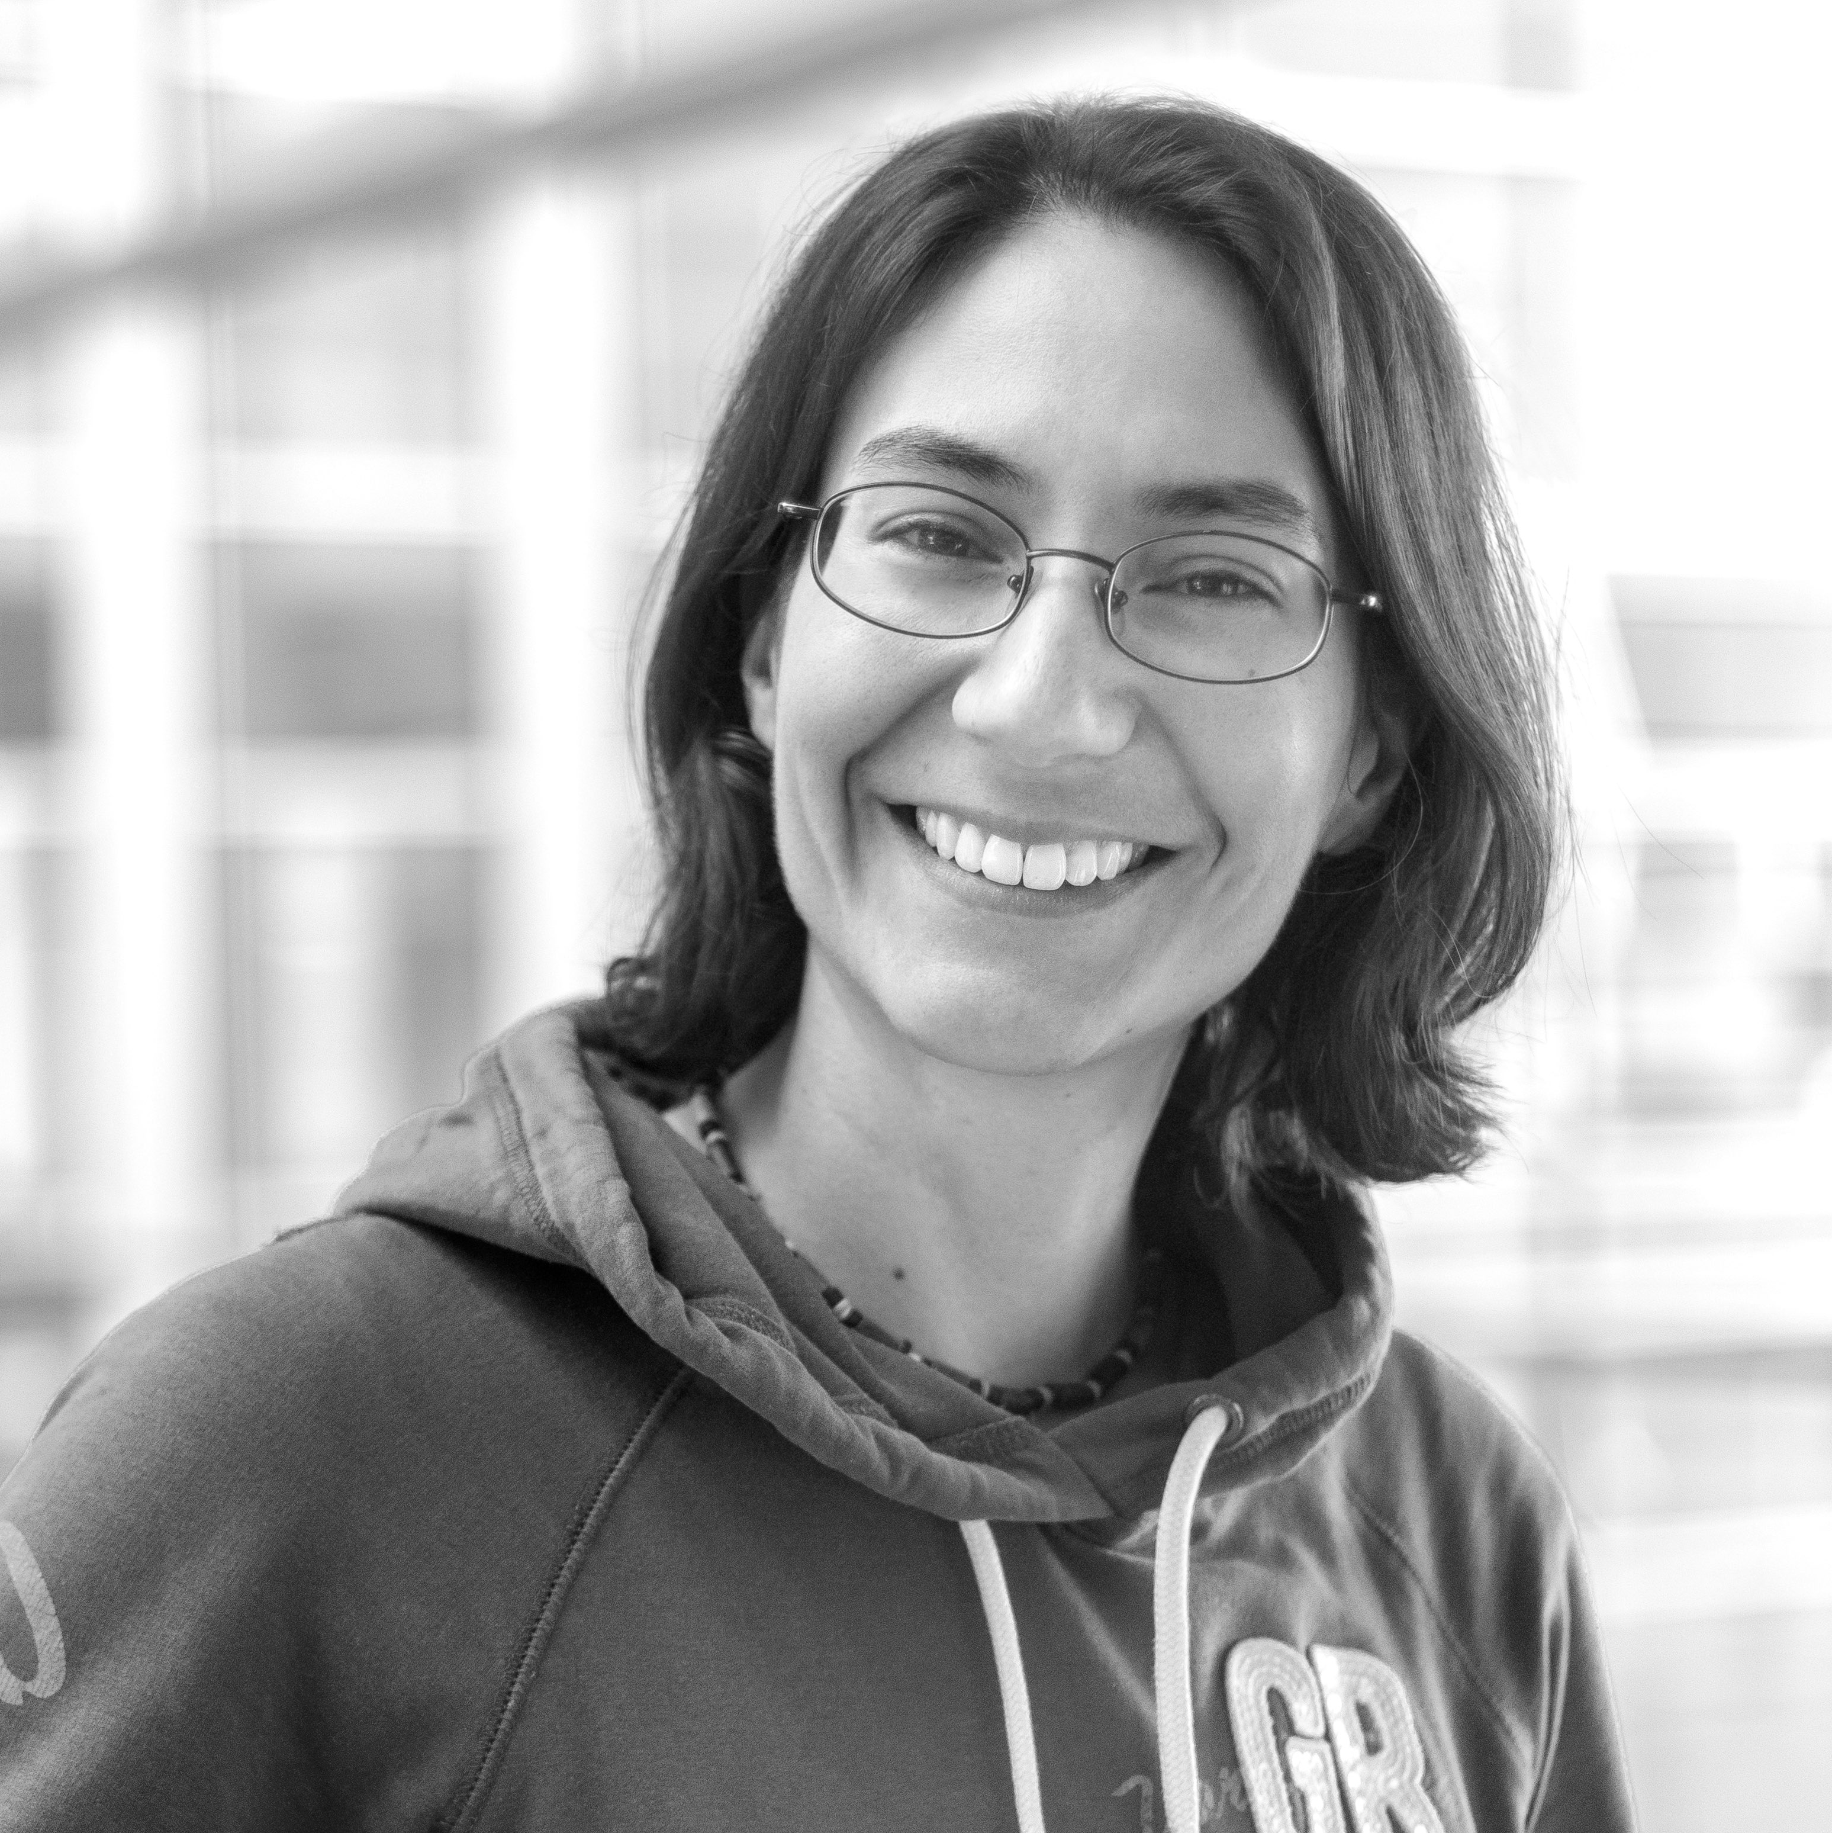

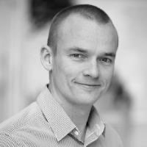
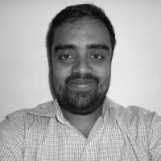
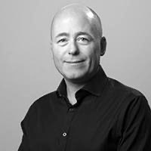
WHO ARE WE
CENTER FOR HEALTH DATA SCIENCE:
Anders Krogh, Professor, Head of Center
Thilde Terkelsen, Data Scientist
DANSTEM:
Magali Michaut, Research Consultant
ANDERS KROGH
THILDE TERKELSEN
MAGALI MICHAUT
GLOBE INSTITUTE:
Bent Petersen, Associate Professor
Shyam Gopalakrishnan, Associate Professor
KU IT:
Allan Have Sørensen, Head of Section
BENT PETERSEN
SHYAM GOPALAKRISHNAN
ALLAN HAVE

Slide 8
C2 WORKSHOP PROGRAM
DATE: 18th of February, 2021
TIME & PLACE: 09.00-16.00 on Zoom
09.00 - Welcome
09.10 - Introduction to Computerome 2.0
09.50 - The Basics
10.10 - Exercise 1.0
10.40 - Coffee Break // Troubleshooting
11.00 - Working on Computerome 2.0
11.20 - Exercise 2.0
11.50 - Q&A
12.00 - Lunch
13.00 - A Technical Intermezzo
13.15 - C2 Modules and Queue System
13.45 - Exercise 3.0
14.30 - Coffee Break // Troubleshooting
15.00 - Optimization of Time and Cost
15.20 - Exercise 4.0
15.45 - Q&A and Outro

